Slide 1



Iris Tumor
Detection Using CNN Model
Team 1
Himanshi Singh
Deena Grace
Arsalan Shaikh

Slide 2
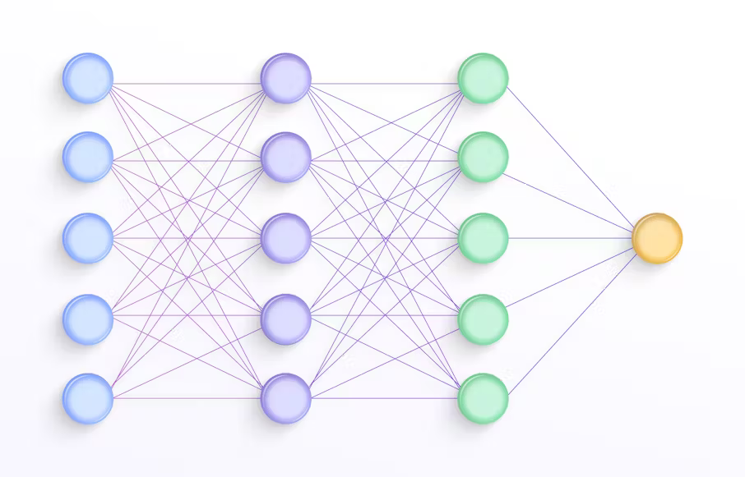



INTRODUCTION
The Iris Tumor Detection project using a Convolutional Neural Network (CNN) focuses on identifying tumors in iris images through deep learning. The CNN model processes preprocessed images to extract key features, enabling accurate tumor detection by analyzing patterns specific to tumor indicators. The system involves stages of image preprocessing, tumor detection, and result reporting, offering a streamlined and effective approach to assist in early diagnosis.

Slide 3
PROJECT OVERVIEW
COMPREHENSIVE APPROACH
This project takes a
comprehensive approach to iris tumor detection, combining robust data collection,
advanced image processing, and state-
of-the-art deep learning
algorithms.
Improved Outcomes
By automating the detection process, this solution aims to enhance the accuracy
and speed of diagnosis,
ultimately leading to better patient outcomes.
Scalable and Efficient
The system is designed to be scalable and efficient, enabling seamless integration into clinical workflows and
facilitating widespread adoption.

Slide 4
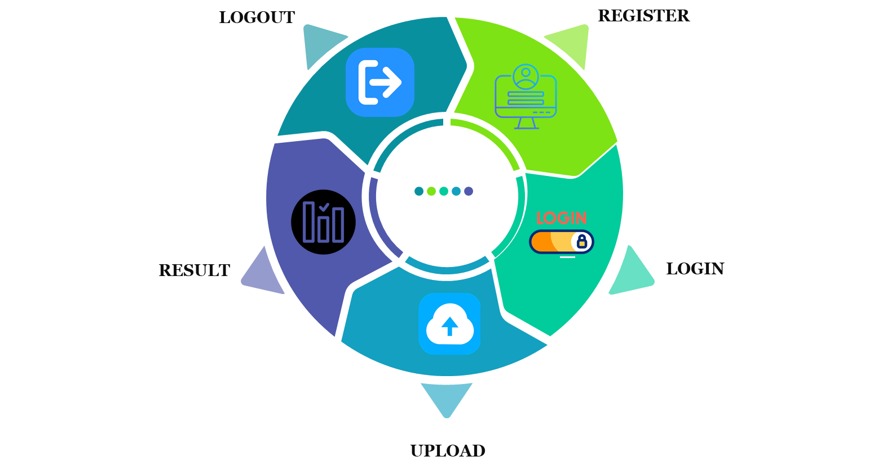
CUSTOMER FEATURES

Slide 5
METHODOLOGY
Data Collection and Preprocessing
Collect high-resolution iris images and preprocess them for training.
CNN Model Training
Train a Convolutional Neural Network (CNN) using TensorFlow/Keras.
Web Platform Development
Build a user-friendly interface with Django and JavaScript.
Testing and Optimization
Conduct multi-level testing to ensure accuracy and reliability.

Slide 6
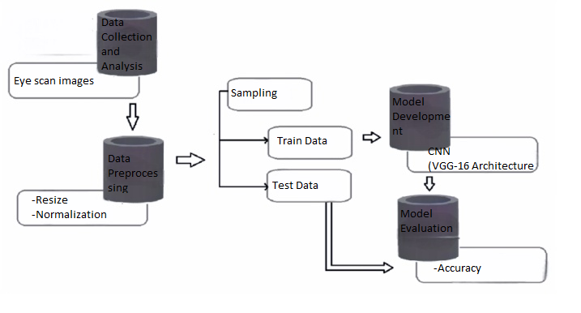
ARCHITECTURE DIAGRAM

Slide 7
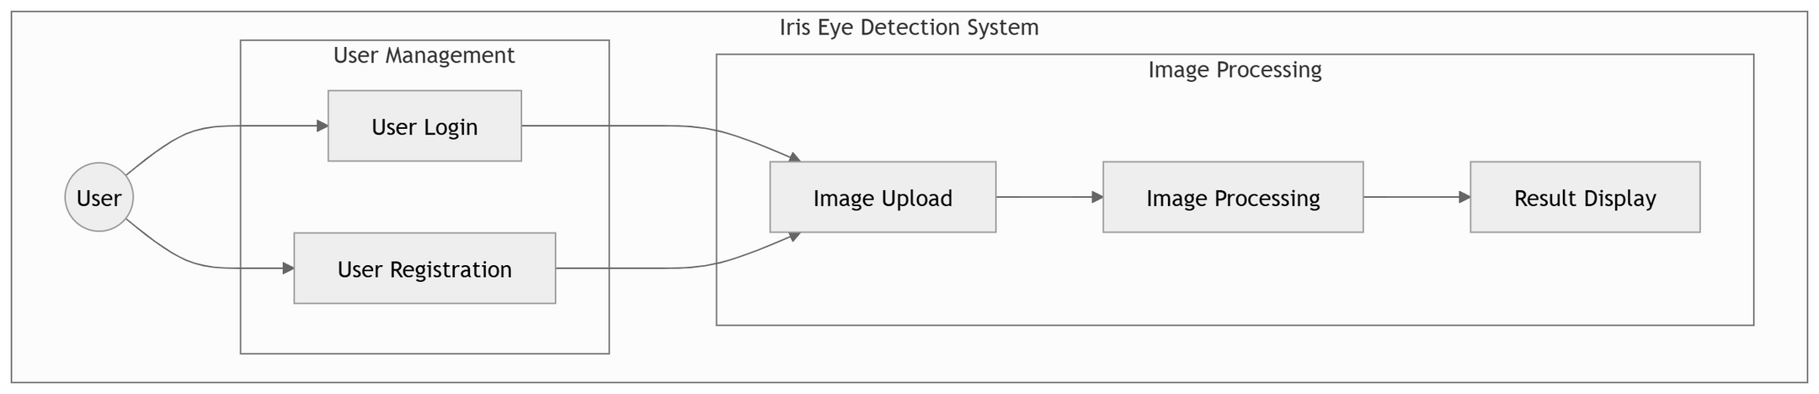
USE CASE DIAGRAM

Slide 8
MILESTONES
Interface Development & Integration :
Develop a user interface for image upload and tumor detection, integrating it with the trained model.
Data Collection & Preprocessing:
Gather a dataset of labeled iris images and preprocess them for model training.
Model Design & Training :
Design a CNN architecture, train it on the dataset, and evaluate its performance.
Model Testing & Optimization :
Test the model on unseen data, fine-tune hyperparameters, and optimize for accuracy.

Slide 9
TECH STACK
FrontEnd :-
HTML , Css , JavaScript
Ai/ML :-
Tensorflow/keras
BackEnd:-
Python,Django
Database :-
MYSQL

Slide 10
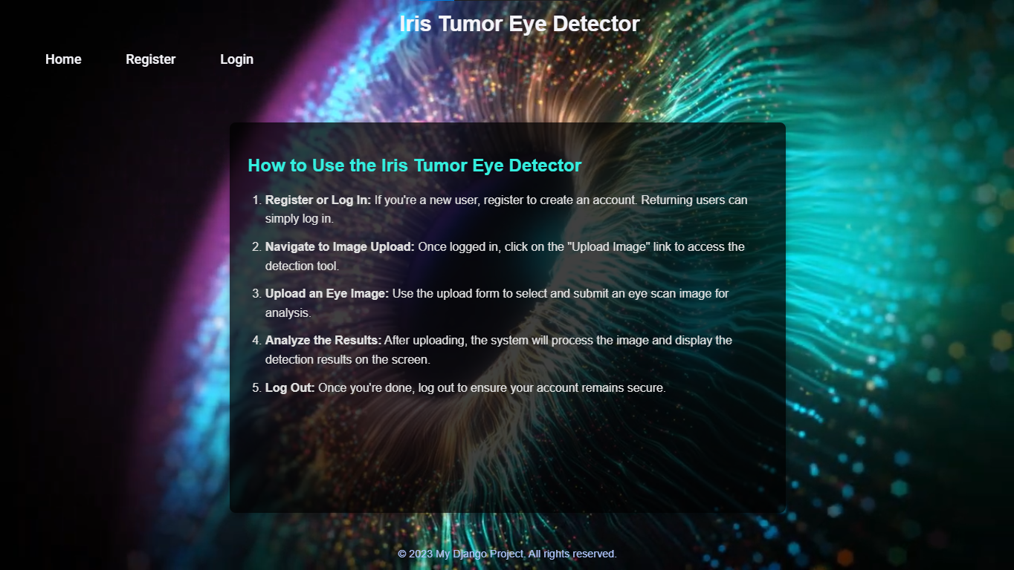
HOME PAGE

Slide 11
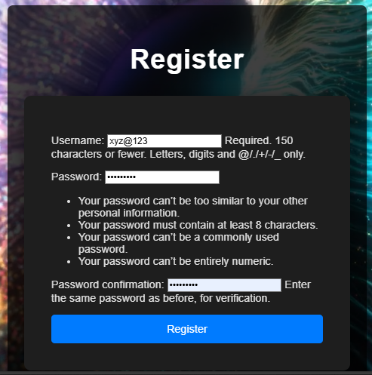
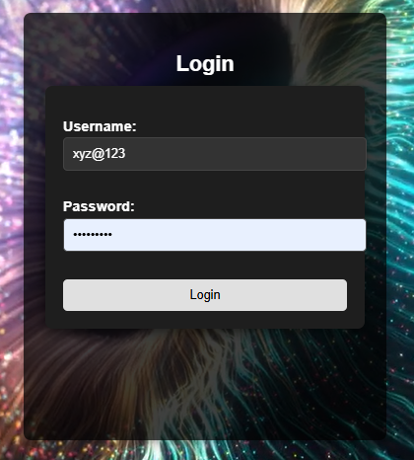
REGISTER/LOGIN PAGE

Slide 12
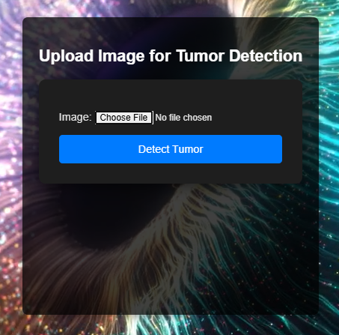
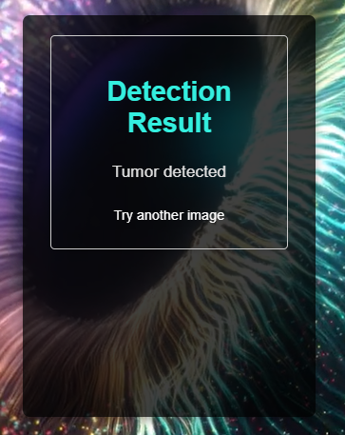
UPLOAD IMAGE/RESULT PAGE

Slide 13
FUTURE SCOPE
Integration with Hospital Systems
Link the platform with hospital management systems for streamlined workloads
Real-Time Detection
Enable real-time tumor detection during medical examinations.
Dataset Expansion
Include diverse datasets to enhance model accuracy.
Mobile
Develop a mobile app and use cloud services for scalability and remote use.

Slide 14
CONCLUSION
The iris tumor detection project successfully demonstrates the potential of deep learning in early diagnosis by using a CNN model to identify tumors in i r is images. Through data collection, model training, and interface development, this project provides a streamlined, user- friendly solution for tumor detection, aiming to aid healthcare professionals in making faster, more accurate diagnoses. Further optimization and integration with real- world medical data could enhance i ts effectiveness and reliability, making i t a valuable tool in medical diagnostics.

Slide 15
THANK YOU!

